Slide 1


Seminar
On
Bluejacking
Submitted To: Submitted By:
Aishwarya miss Hiba Parveen P

Slide 2
Content
Introduction
Bluejacking Technology
Architecture
Technical Features
How to Bluejack
Usage of bluejacking
Related concepts
Future aspects
Conclusion
Reference

Slide 3

Introduction
Bluejacking
Sending of unsolicited messages over Bluetooth to Bluetooth-enabled devices such as mobile phones, PDAs or laptop computers via the OBEX protocol.
Origin
Started after a Malaysian IT consultant named “Ajack” posted a comment on a mobile phone forum.

Slide 4

Bluejacking Technology
Bluetooth technology
vCard
OBEX protocol

Slide 5
Continued….
Short range wireless LAN
Connects numerous devices of different functions like telephones, notebooks, computers, digital cameras etc. , in Personal Area Network (PAN).
Three areas - Data and Voice access points, Cable replacement, and Ad hoc networking.
Supports point - to - point as well as multi-point.
Low power
Low cost single chip radio – feasible

Slide 6

Architecture
Piconet
The devices find each other and form a network called “ piconet ” spontaneously.
A piconet is a basic unit with up to 8 nodes, one of which is a master and up to seven active slave nodes within a maximum distance of 10 meters.
All communication between master and slaves.
Piconet is a centralized TDM system.
Master controls clock and decides the time slot for the device.
In a piconet , there can be up to 255 parked nodes.
Master switches to low power state and parked node wait for beacon from master.

Slide 7
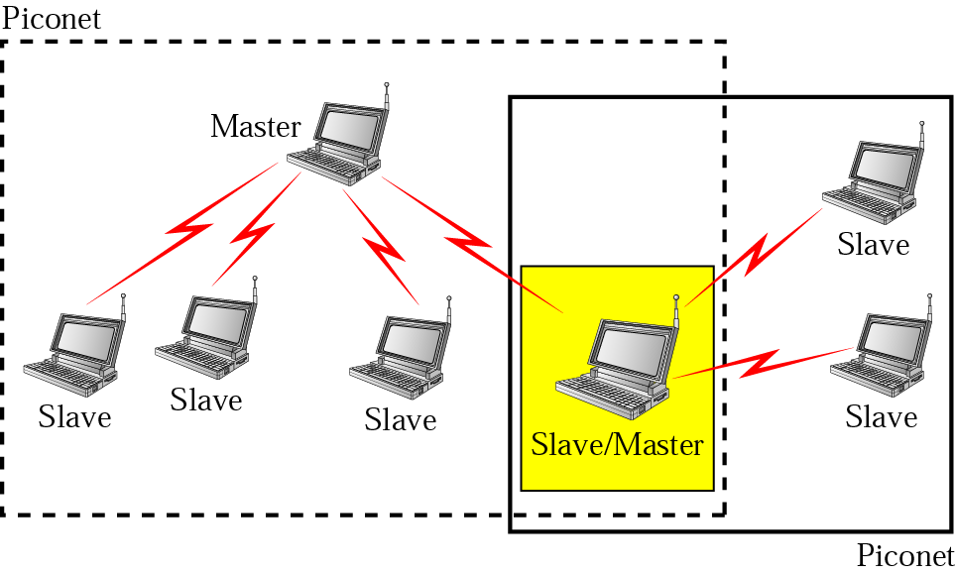

Slide 8

Technical Features
Connection Type | Spread Spectrum (Frequency Hopping) & Time Division Duplex (1600 hops/sec)
Spectrum | 2.4 GHz ISM Open Band (79 MHz of spectrum = 79 channels)
Modulation | Gaussian Frequency Shift Keying
Transmission Power | 1 mw – 100 mw
Data Rate | 1 Mbps
Range | 30 ft
Supported Stations | 8 devices
Data Security –Authentication Key | 128 bit key
Data Security –Encryption Key | 8-128 bits (configurable)
Module size | 9 x 9 mm

Slide 9
Classification
Classification of devices on the basis of Power dissipated & corresponding maximum Range.
 | POWER | RANGE
CLASS I | 20 dBm | 100 m
CLASS II | 0-4 dBm | 10 m
CLASS III | 0 dBm | 1 m

Slide 10

How to Bluejack
Mobile
Personal computers
Software tools
Bluespam
Searches for all discoverable Bluetooth devices and sends a file to them (spam's them) if they support OBEX.
By default a small text will be send.

Slide 11
Continued….
Customize the message that should be send you need a palm with an SD/MMC card, then you create the directory /PALM/programs/BlueSpam/ Send/ and put the file you would like to in into this directory. Activity is logged to /PALM/programs/BlueSpam/Log/log.txt.
Mobiluck

Slide 12
Continued….
Meeting point
Is compatible with pocket PC, palm, Windows.
Proximity mail
Easyjack
Freejack
Freejack is compatible to java phone like Nokia N-series.

Slide 13

Usage of bluejacking
Busy shopping centre
Starbucks
Train Station
High Street
On a train/ tube/ bus
Cinema
Café/ restaurant/ pub
Mobile phone shop
Electronics shop (e.g. Dixons)

Slide 14
Places where bluejack occurs

Slide 15
Continued…
Advertisement
Marketing opportunity
Viral communication
Community activities
Location based service

Slide 16
Code of ethics
Do not hack any device
Don't send abusive messages
Don't threaten anyone
Don't put your personal information in a BlueJack message
Don't reveal yourself to the 'victim'
Do disable Bluetooth if you don't want to be BlueJacked

Slide 17

Related concepts
Bluesnarfing
Bluecasting
Bluebugging

Slide 18

Bluesnarfing
Is the unauthorized access of information from a wireless device through a Bluetooth connection, often between phones, desktops, laptops, and PDAs.
Even if your device is hidden bluesnarfing can also be done.

Slide 19
Bluecasting
Provision of any small digital media to suitable media provisioning enabled devices over Bluetooth via the OBEX protocol.

Slide 20
Bluebugging
Form of Bluetooth attack.
Allows the user to take control of a victim's phone to call the user's phone.

Slide 21

Security issues
Earlier issue
Promotes an environment that puts consumer devices at greater risk.
Complete memory contents of some mobile phones can be accessed by a previously trusted paired device.
Phonebook and calendar can be obtained without owners knowledge.

Slide 22
Present Scenario
primarily occurs in public spaces
Security issues previously involved with bluejacking has been resolved.
In order for information to be duplicated, the devices would have to be paired. Bluejacking does not require a password to be entered and therefore the two devices are not paired

Slide 23
Counters-measures
Turn off your Bluetooth device until you need to communicate with another user.
Buy an E2X bag.
It blocks all transmissions and receiving signals from leaving the bag.

Slide 24
Future aspects
Act as major sale tool
learn user preferences by placing options like "more ads like this" and "less ads like this" in each advertisement.

Slide 25
Conclusion
Because of its low cost and power consumption this technology has a great future ahead.

Slide 26
Reference
www.google.com
www.wikipedia.com
www.studymafia.org

Slide 27
Thanks

Slide 28

Any questions?

